Slide 1
TOPIC : motion in a straight line
GRADE : XI
SUBJECT : PHYSICS

Slide 2
Describing motion
To locate the position of object we require a reference point (origin) and a set of axes.
The coordinates (x,y,z) describe the position of object.
The coordinate system along with the clock is known as the frame of reference.

Slide 3
Distance:
The actual path length travelled by the object is known as distance.
It is Scalar quantity.
Displacement:
The change in position is known as displacement.
Displacement = Final position –Initial position
Δx = x₂ – x₁
x₂ > x_{1,} Δx– is positive
x₂ < x_{1,} Δx– is negative

Slide 4
Position –time Graph:(x-t graph)
The motion of the object can be represented by position –time graph.
8
6
40
30
4
20
X (m)
x (m)
2
10
0
10
20
30
40
0
1
2
3
4
t (S)
t (S)
Object is at rest
Object in uniform motion

Slide 5
8
6
4
Position(m)
2
0
1
2
3
4
Time (S)
Object in non-uniform motion
i.e. accelerated motion

Slide 6
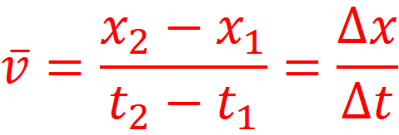
Average velocity:
Average velocity is defined as displacement (Δx) divided by time interval (Δt)
It is measured in ms⁻¹

Slide 7
Average Speed:
Average speed is defined as the total path length travelled by the object divided by time interval.
It is measured in ms⁻¹

Slide 8
X-t graph for two children A and B returning from their school O to their houses P and Q resp.
Choose the correct entries in the bracket
Q
P
A
1.(A/B) lives closer to the school than(B/A)
X (m)
B
2.(A/B) stars from the school earlier than(B/A)
0
t (S)
3.(A/B) walks faster than(B/A)
4. A and B reach home at the (same/different) time.
5.(A/B) overtakes(B/A) on the road (once/twice)

Slide 9
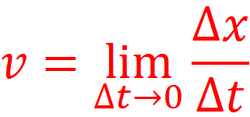
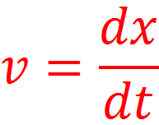
Instantaneous Velocity:
The velocity at an instant is defined as the limit of average velocity as the time interval becomes infinitesimally small(Δt tends to zero)
The instantaneous velocity is also defined as the rate of change of position at that instant.
The instantaneous velocity is the time derivative of position.

Slide 10
Instantaneous Speed:
The magnitude of an instantaneous velocity is called as instantaneous speed.
Speed associated with both the velocities will 25 ms⁻¹

Slide 11
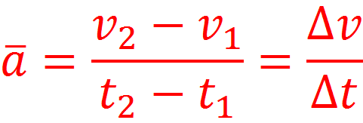
Average Acceleration:
Average acceleration is defined as change in velocity (Δv) divided by time interval (Δt)
It is measured in ms⁻²

Slide 12
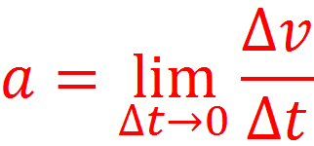
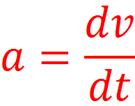
Instantaneous acceleration:
The acceleration at an instant is defined as the limit of average acceleration as the time interval becomes infinitesimally small (Δt tends to zero)
The instantaneous acceleration is also defined as the rate of change of velocity at that instant.
The instantaneous acceleration is the time derivative of velocity.

Slide 13
The Position –time graph
x
x
x
O
t
O
O
t
t
Positive
Acceleration
Negative
Acceleration
Zero Acceleration

Slide 14
The velocity time graph
v
v
v₀
v₀
O
t
O
t
Object is moving in positive direction with positive acceleration
Object is moving in positive direction with negative acceleration

Slide 15
v₀
t
t₁
t₂
O
O
-v₀
-v
-v
Object is moving in negative direction with negative acceleration
Object is moving with negative acceleration through out. Between 0 to t₁ it moves + x-direction and between t₁ to t₂ it moves in opposite direction.

Slide 16
Area under Velocity-time Graph.
A
B
40
v
Velocity -Time Graph for object moving with constant velocity.
30
20
Velocity(km)/h
Area under
Velocity-Time graph
Area of Rectangle OABC
10
t
0
c
=
o
1
2
3
4
Time (h)
= OA x OC
= v x t
Product of velocity and time is equal to displacement.
Area under Velocity –Time graph is always equal to the distance travelled by an object.

Slide 17
Kinematic equations of uniformly accelerated motion
E
B
v
If the object is moving with constant acceleration then inst,acceleration is equal to av.acceleration
v-v₀
v₀
C
A
1.velocity-time relation
0
D
t
t
v = v₀ +at
This is velocity-time relation

Slide 18
2. Position -time relation
E
B
v
Area under v-t graph.
v-v₀
v₀
C
A = Ar.of Rec.OACD +Ar of Tri. ACB
A
A = (AO x OD)+ ½ (Ac x BC)
0
D
t
t
A = (v₀ x t)+ ½ (v-v₀) x t
x = v₀t + ½ a t²
A = v₀t + ½ (v₀ +at-v₀) x t
A = v₀t + ½ a t²
x –x₀= v₀t + ½ a t²

Slide 19
3. Position –velocity relation
E
B
v
Area under v-t graph.
v-v₀
Area of trapezium OABD
v₀
C
A
A = ½ x OD (OA +BD)
0
D
t
t
A = ½ x t (v₀ +v)
x = (v²-v₀²)/2a
A = ½ x (v-v₀)/a x (v₀ +v)
x-x₀ = (v²-v₀²)/2a
A = (v-v₀)x (v + v₀)/2a
2a(x-x₀ )= v²-v₀²
A = (v²-v₀²)/2a

Slide 20
Home work
1.A ball thrown vertically upwards with a speed of 19.6 m/s from the top of the tower returns to the earth in 6 seconds. Find the height of the tower.
2.A car moving along the straight highway with a speed of 126 km/h ,is brought to a stop within a distance of 200 m. What is the retardation of the car and how long does it take for the car to stop?

Slide 21
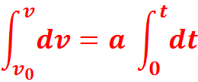
Equations of motion by Calculus method
1. velocity-time relation.
Acceleration
Integrating on both sides
This is velocity-time relation.

Slide 22
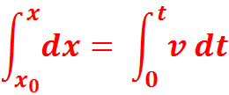
2. Position-time relation.
velocity
Integrating on both sides
This is Position-time relation.

Slide 23
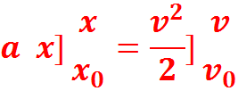
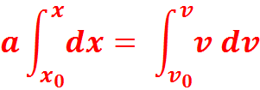
3.Velocity-Position relation.
Integrating on both sides
This is velocity-Position relation.

Slide 24
Relative velocity
Consider two objects A and B moving
uniformly with average velocities v_{A} and v_{B} along x-axis. If x_{A} (0) and x_{B} (0) are positions of objects A and B,respectively at time t = 0, their positions x_{A} (t) and x_{B} (t) at time t are given by:
x_{A} (t ) = x_{A} (0) + v_{A} t --------1
x_{B} (t) = x_{B} (0) + v_{B} t --------2
displacement of object B w.r.t. object A is
x_{BA}(t) = x_{B} (t) – x_{A} (t)
x_{BA}(t) = [ x_{B} (0) – x_{A} (0) ] + (v_{B} – v_{A}) t. ----3
Object B has a velocity v_{B} – v_{A} w.r.t. A

Slide 25
The velocity of object B relative to object A is v_{B} – v_{A}
v_{BA} = v_{B} – v_{A}
The velocity of object A relative to object B is v_{A} – v_{B}
v_{AB} = v_{A} – v_{B}

Slide 26
B
140
140
A
120
120
A
100
100
80
80
B
X(m)
60
X(m)
60
40
40
20
20
O
1
2
3
4
5
6
O
1
2
3
4
5
6
t(s)
t(s)
v_{A} = v_{B}
v_{A} – v_{B} = 0
v_{B} - v_{A} = 0
v_{A} > v_{B}
The two objects stay at a constant distance
v_{B} - v_{A} is negative
Objects meet at a
common point

Slide 27
140
120
A
100
80
X(m)
60
40
B
20
O
1
2
3
4
5
6
t(s)
v_{A} and v_{B} are of opposite signs.
In this case, the magnitude of v_{BA} or v_{AB} is
greater than the magnitude of velocity of A or
that of B

